Slide 1
Embeded vs Reference Model. Transactions.
+ Aggregation

Slide 2
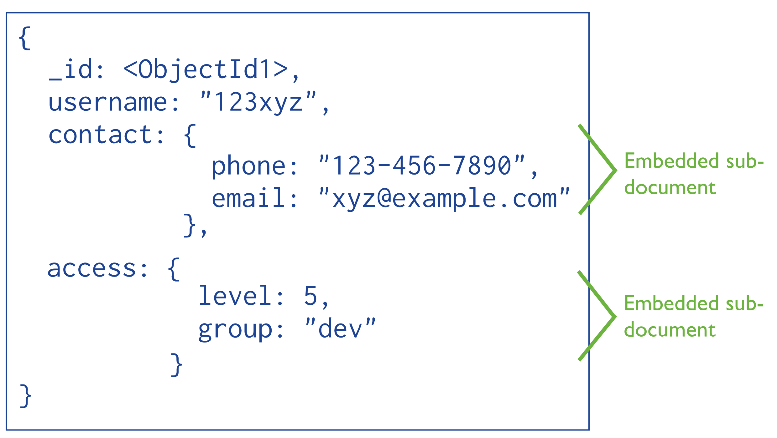
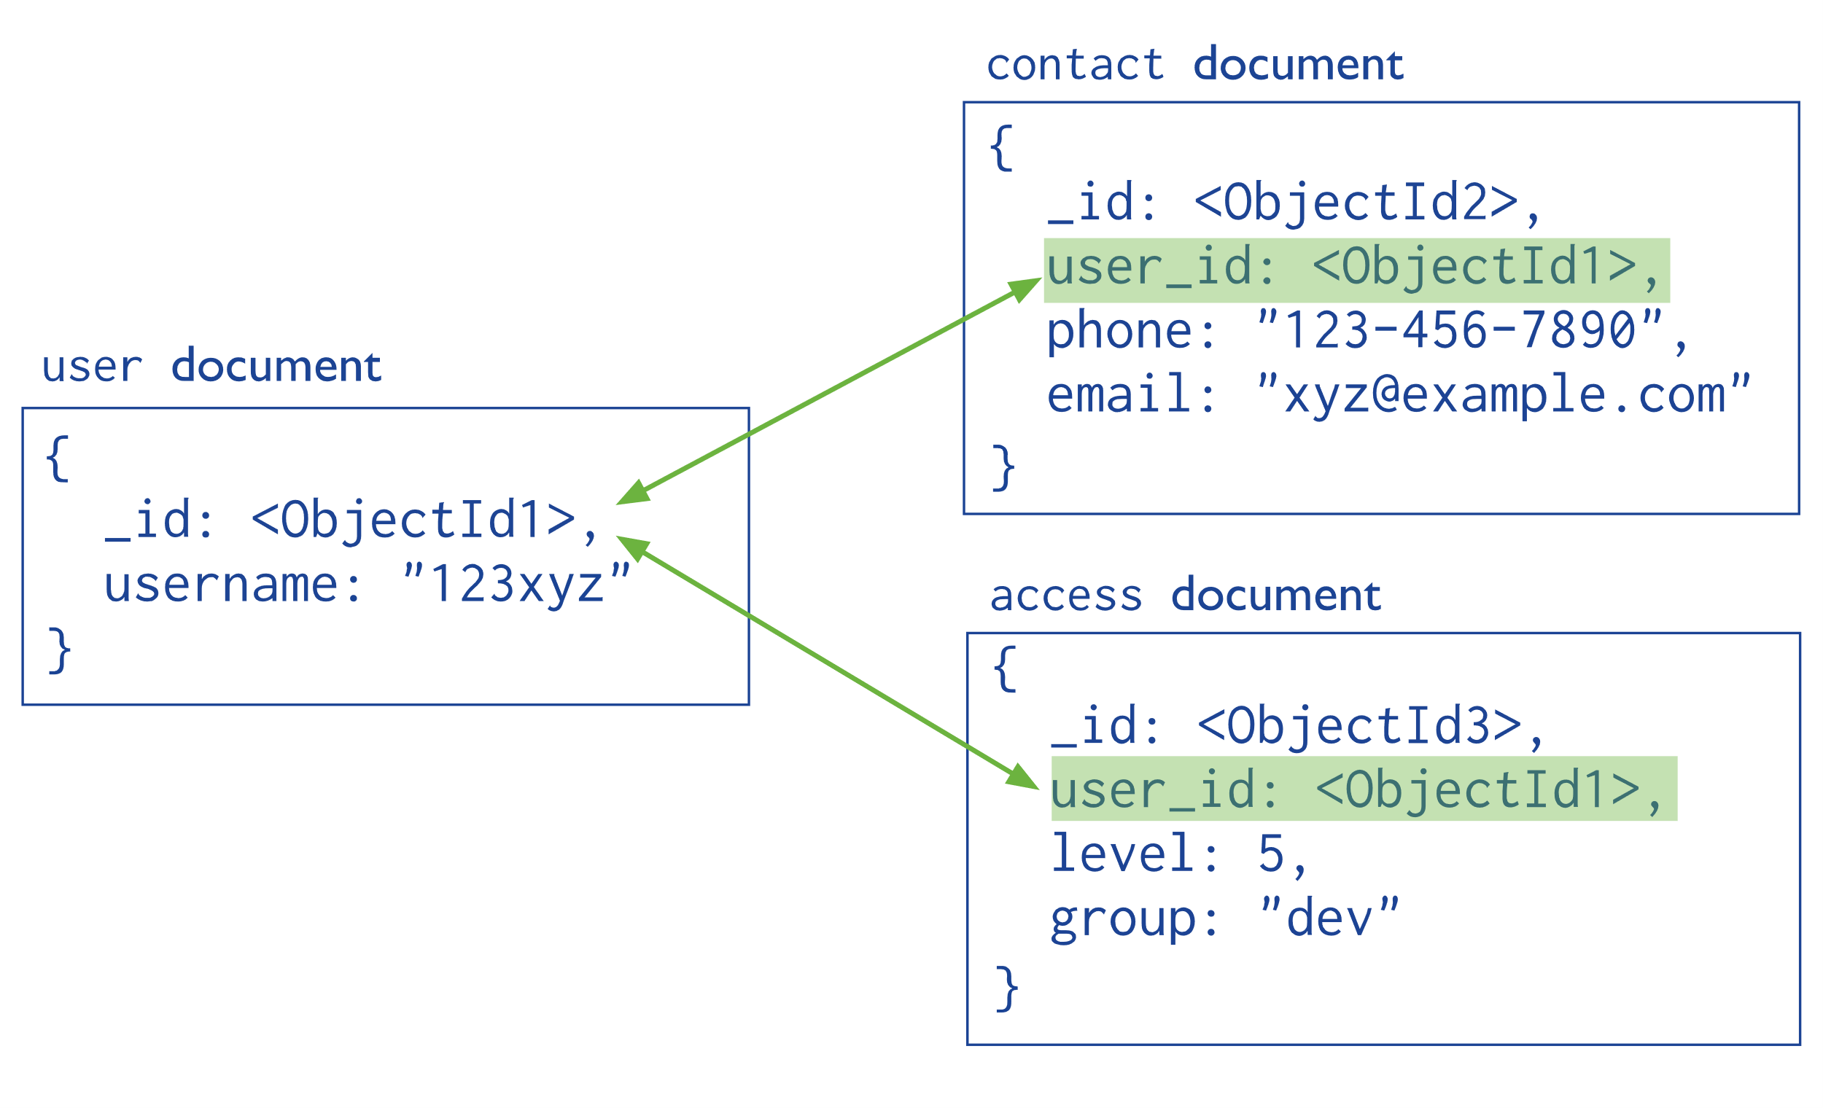
Embedded Model vs Reference Model
Reference model
Embedded model

Slide 3
Embeded Model
//Employee document
{
"_id" : ObjectId(...),
"name" : "John Smith",
"department" : "dev",
"salary" : 4000,
"addresses" : [
{
"type" : "office",
"city" : "Sofia",
"street" : "Tsarigradsko Shose 47"
},
{
"type" : "home",
"city" : "Sofia",
"street" : "Boulevard Bulgaria 61"
},
{
"type" : "home",
"city" : "Plovdiv",
"street" : "Hristo Botev 2"
}
]
}
Data is always read together
Data has the same lifecycle
Fits well for 1:1 and 1:M
The array size is limited (not growing indefinitely), max doc. size = 16 MB
You need fast reads

Slide 4
Embeded Model
//Orders collection
[
{
"_id": "ORD_001",
"customer_name": "Ivan Ivanov",
"address": {
"city": "Sofia",
"street": "Kliment Ohridski 8"
},
"products": [
{
"name": "Lenovo Thinkpad T15 Gen4",
"price": 1500,
"qty": 1
},
{
"name": "Samsung Galaxy S25 FE",
"price": 600,
"qty": 1
}
]
}…
]
Data is always read together
Data has the same lifecycle
Fits well for 1:1 and 1:M
The array size is limited (not growing indefinitely), max doc. size = 16 MB
You need fast reads

Slide 5
Reference Model
//Social Network Post Document
{
"_id" : ObjectId(...),
"user_id" : "user_id",
"post_text" : "What is your favourite NoSQL DB?",
"comments" : [
{
"user_id" : ObjectId("69dbfb96c2f9d8e3922a5f08"),
"text" : "It depends on the use case."
},
{
"user_id" : ObjectId("69dbfb96c2f9d8e3922a5f09"),
"text" : "I enjoy the flexibility of MongoDB."
}
]
}
Data changes frequently
Data is shared across multiple documents
You have many-to-many relationships (M:N)
The embedded array can grow large (unbounded)
//Users Collection
[
{
"_id" : ObjectId("69dbfb96c2f9d8e3922a5f08"),
"name" : "Ivan Petrov"
},
{
"_id" : ObjectId("69dbfb96c2f9d8e3922a5f09"),
"name" : "Dimitar Ivanov"
}
]

Slide 6
How can we display together the Post Comments with their author’s name?

Slide 7
$lookup = SQL JOIN
We use it as Aggregation Stage
Expensive operation
{
$lookup:
{
from: <collection to join>,
localField: <field from the input documents>,
foreignField: <field from the documents of the "from" collection>,
as: <output array field>
}
}

Slide 8
Demo

Slide 9
Transactions

Slide 10
Transactions – ACID properties
Atomicity - Transactions are all-or-nothing; if one operation fails, the entire transaction rolls back.
Consistency - Ensures the database moves from one valid state to another, maintaining data integrity.
Isolation - Concurrent transactions do not interfere with each other, providing snapshot isolation.
Durability - Completed transactions are recorded in the transaction log and persisted, even during a system failure.

Slide 11
When to use Transactions in MongoDB?
You have operations over multiple documents/collections
You have financial operations
You have strong consistency requirements
You cannot embed the data together, in a single document, hence you cannot avoid the use of transactions

Slide 12
Sample Transaction
1
var session = db.getMongo().startSession();
session.startTransaction();
var accounts = session.getDatabase("bank").accounts;
try {
accounts.updateOne( { username: "borislav" }, { $inc: { balance: -100 } } );
accounts.updateOne( { username: "ivan" }, { $inc: { balance: 100 } } );
session.commitTransaction();
} catch (error) {
print("An error occured: " + error);
session.abortTransaction();
} finally {
session.endSession();
}
2
3
4
5
Establish Session
Start Transaction, from the particular Session
Get instance to DB and Collection FROM WITHIN Transaction
Perform CRUD operations
Commit Transaction
End Session
6
Note! Transaction lifetime is 60 seconds by default!

Slide 13
Demo

Slide 14
Let’s do the Lab!

